Slide 2
Talk 38: The Vietnam War

Slide 3
Preview : Module 6: A Nation Adrift
Talk | Title | Time Period | Date of Talk
37 | The Great Society | 1964-1968 | May 19th
38 | Vietnam | 1961-1975 | June 2nd
39 | US society and culture 1960’s | 1960-1970 | June 16th
40 | Return of the Republicans | 1968-1976 | September 1st
41 | Cold War during the 1970’s | 1969-1980 | September 15th
42 | The “Humility Experiment” | 1976-1980 | September 29th
43 | US society and culture 1980 | 1970-1980 | October 6th

Slide 4
Talk 38: Vietnam
Prequel
Intervention 1964-1965
Americanisation 1965-1967
Tet Offensive 1968
Vietnamization 1969-1972
Abandonment 1973-1975

Slide 5
Prequel

Slide 6
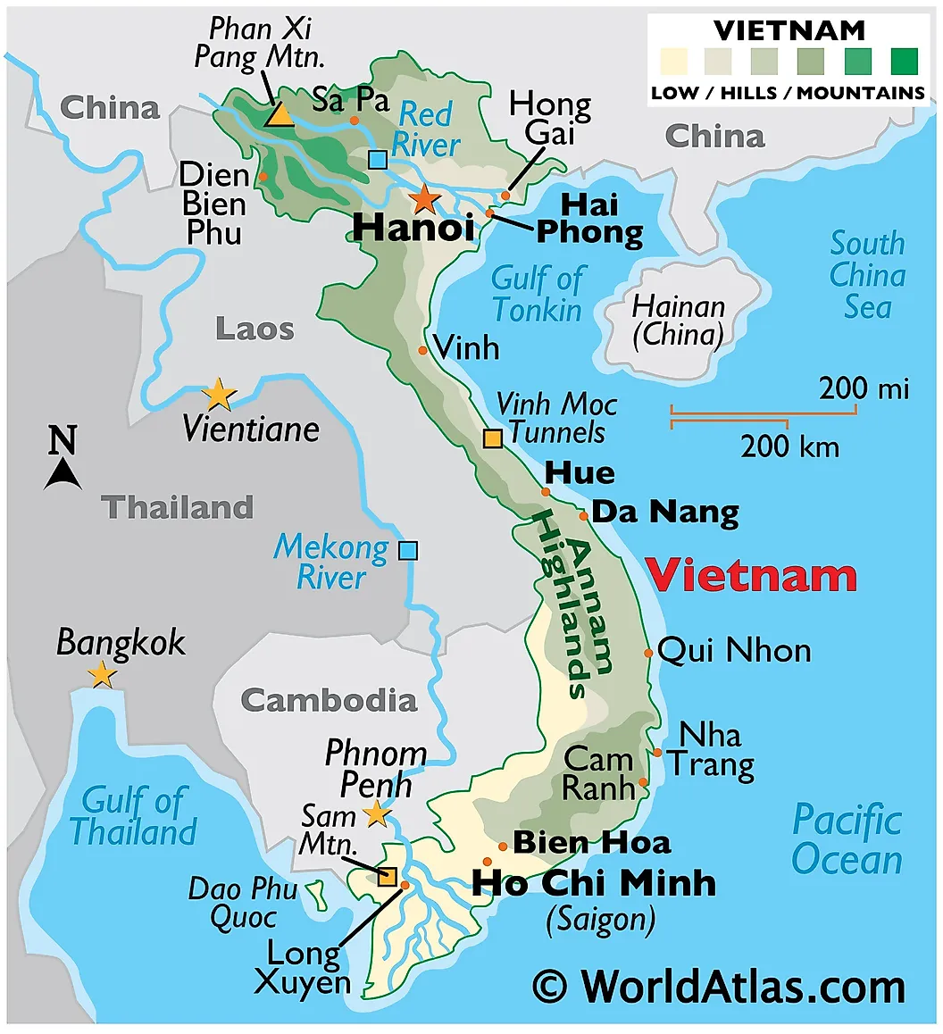
Vietnam today

Slide 7
Vietnam…overview to 1941
Periodically unified prior to 11th to 20th century
Regional divide:
North Confucian Chinese: often “autonomous” region of China
South Bhuddist/ Indian influence….warlord mini kingdoms
Christian missionaries 18th century…more prominent in south
Emperor fears threat of Christian…100,000 killed…pretext for French Invasion 1859
Incorporated into French Indochina 1860’s …North French Capital
Fragmented into Administrative Regions run by French elite/ education.
Occupation brutal…predatory colonialism…rubber plantations
North…industrial/ administration centre small farms/ mining/extractive industries
South ..large scale rice and rubber plantations/ minimal industry…

Slide 8
Northern Highlands

Slide 9
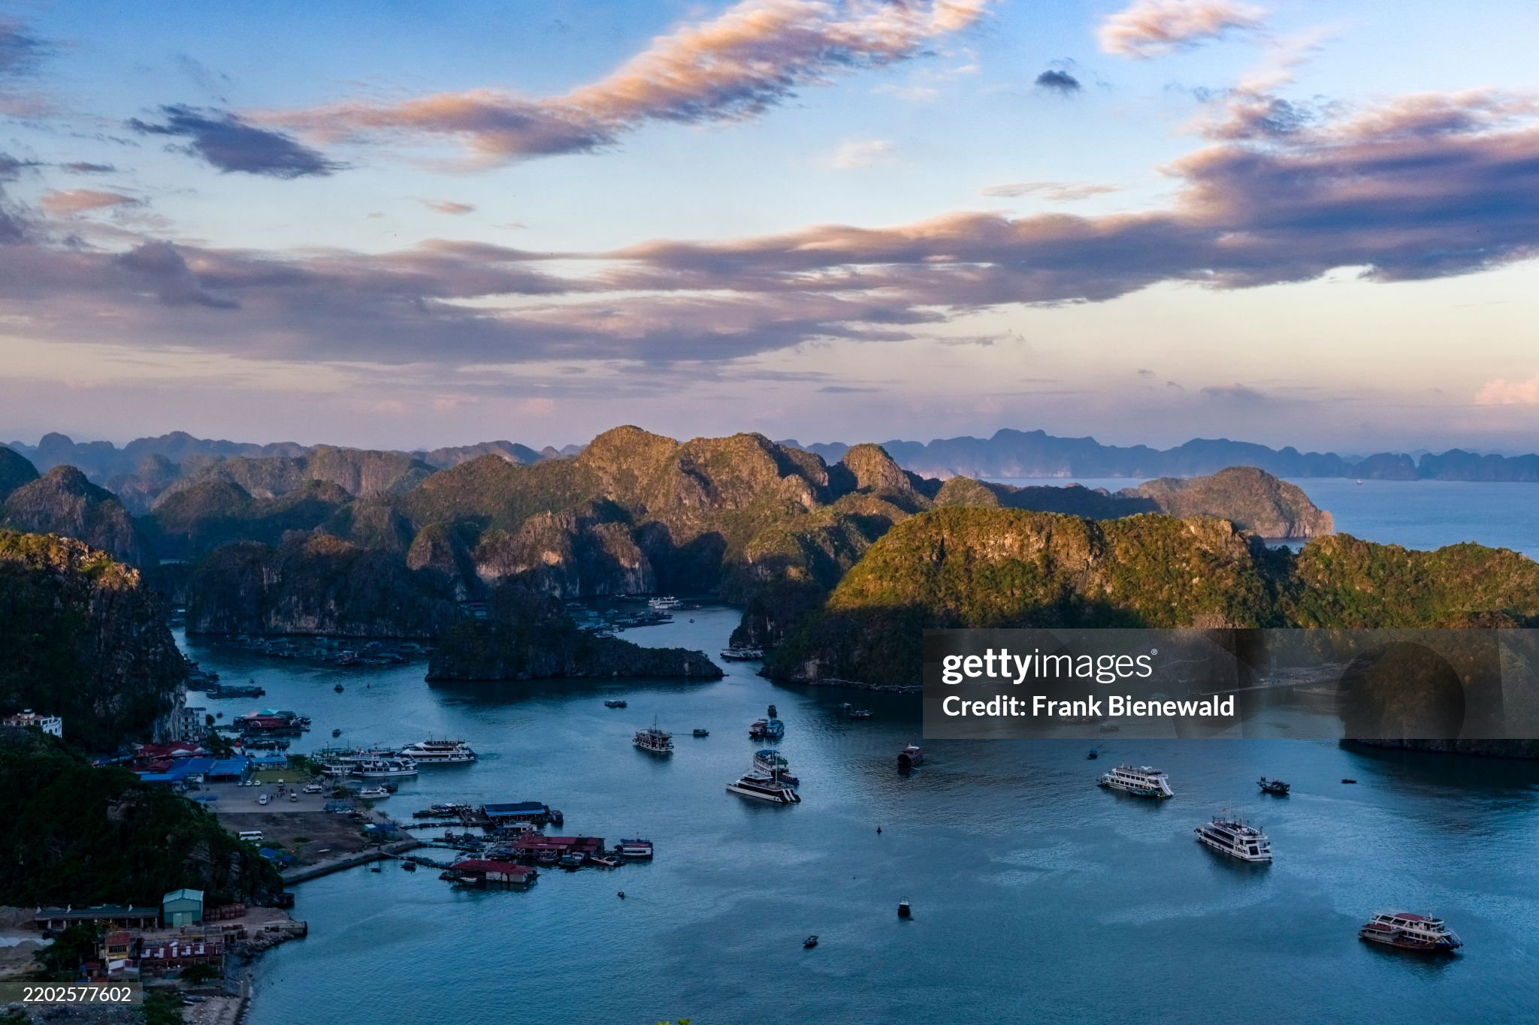
Ha long Bay

Slide 10
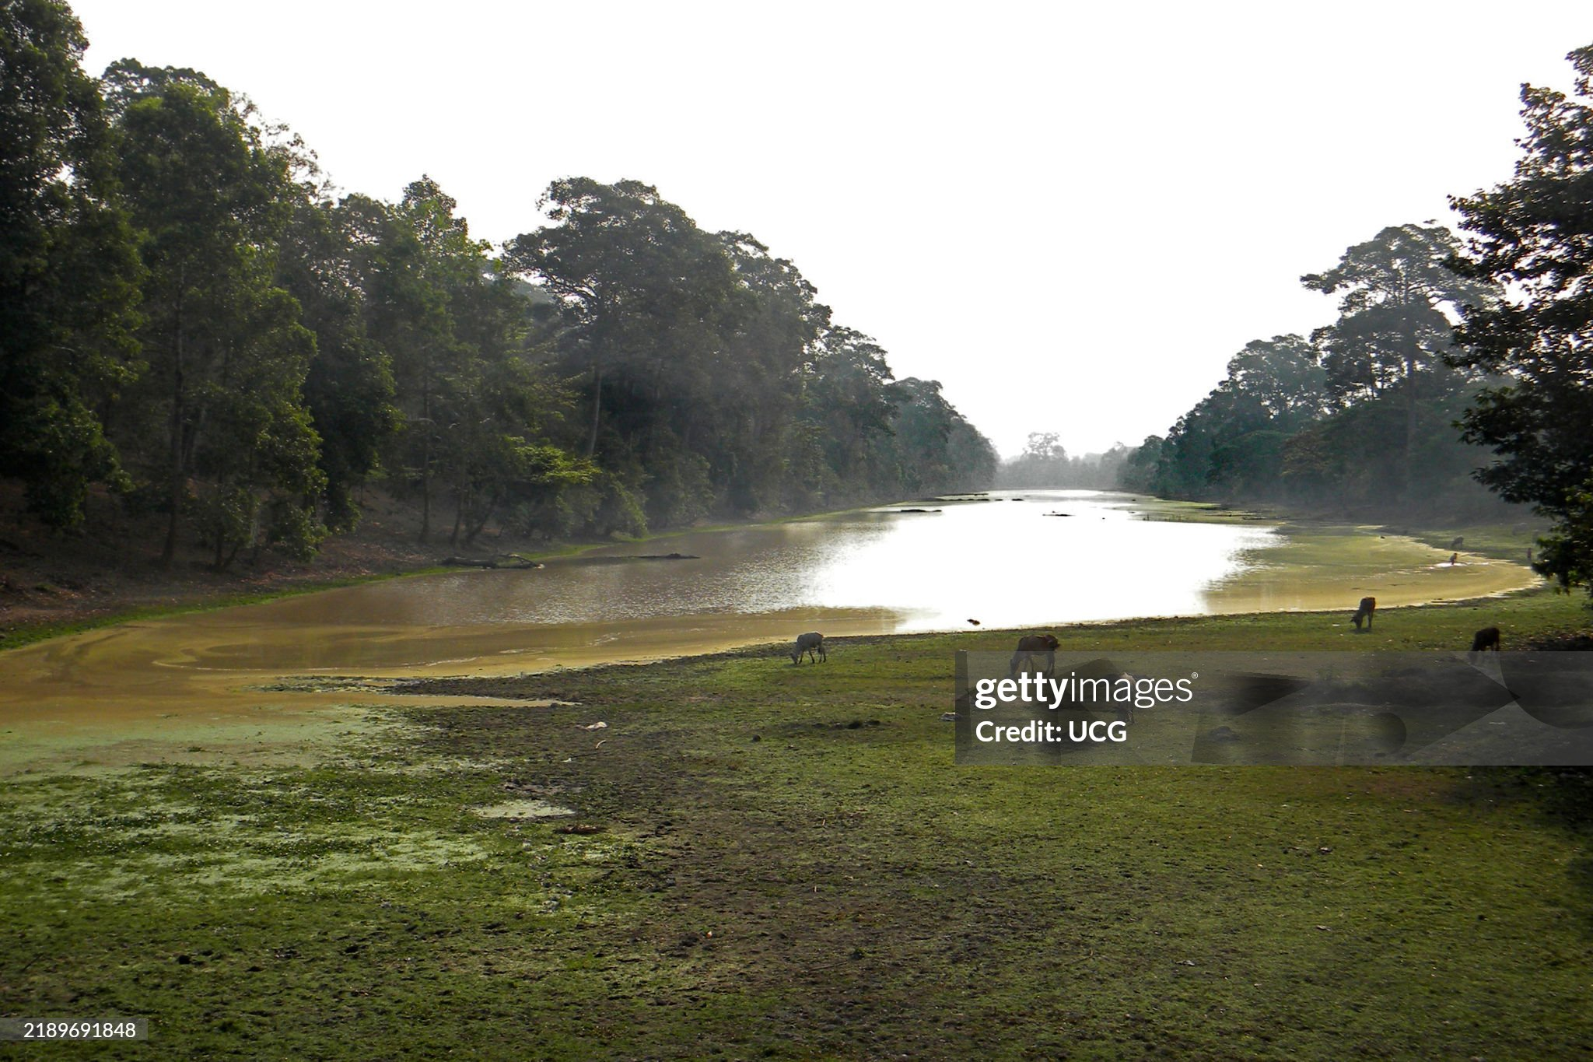
Landscape near Hanoi

Slide 11
Rice paddies….lowlands

Slide 12
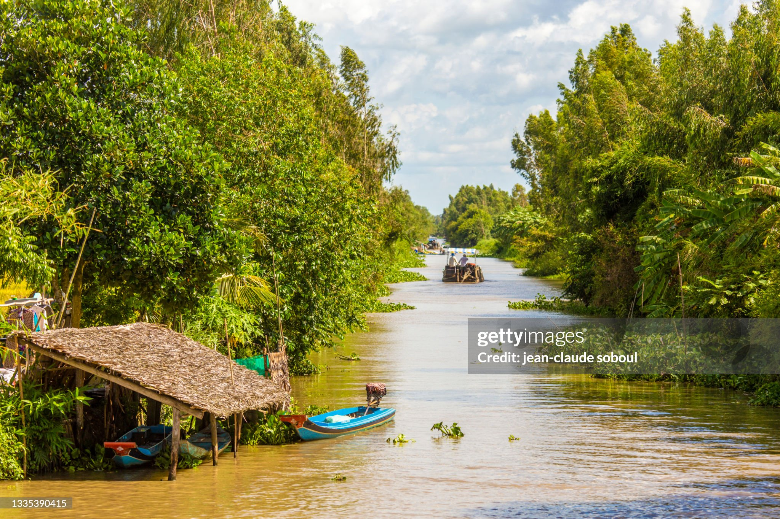
Mekong Delta

Slide 13
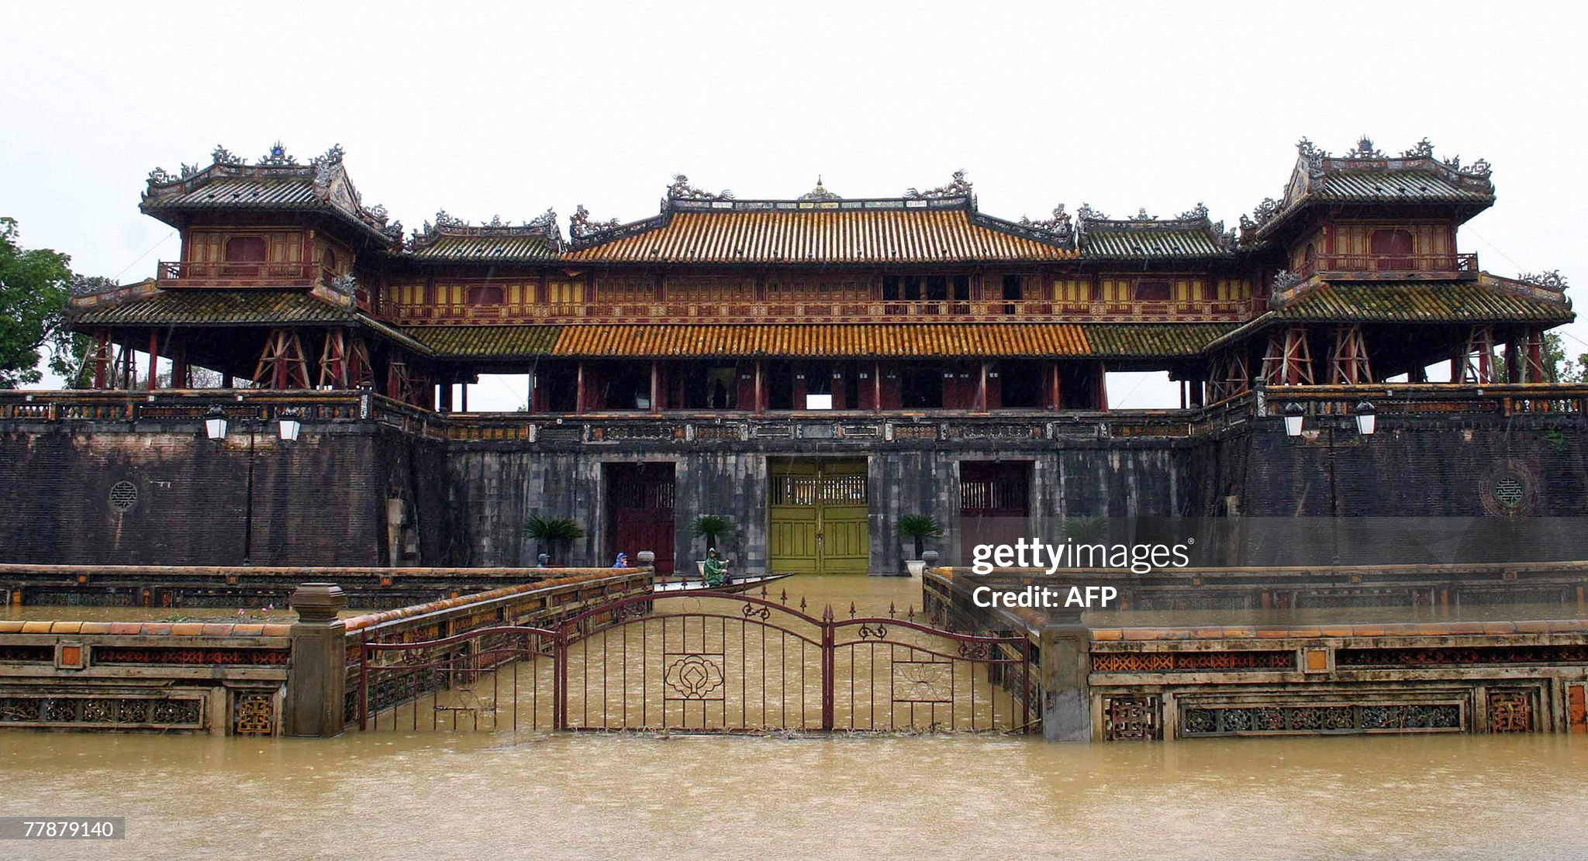
Citadel Hue City (1832…Unified Vietnam)

Slide 14
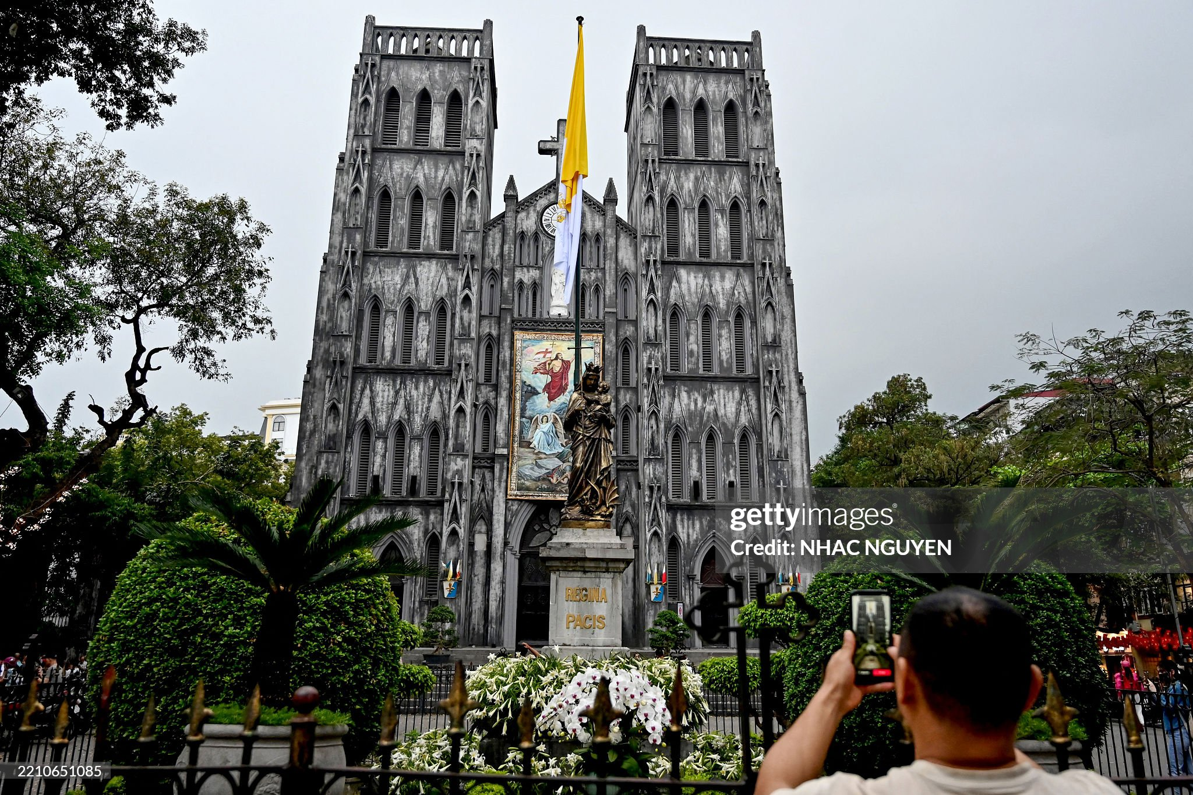
Hanoi Cathedral (completed 1886)

Slide 15
Vietnam 1945-1954
Japanese invade 1941
French (Vichy) army “restricted to barracks”, puppet emperor Bin Dao installed
Ho Chi Minh leads Communist revolt from China 1945, request US recognition
French return to regain “Indochina” 1946
Supported by US as part of “Containment” strategy
French run out of money, US finance, French fight
French defeated 1954 by Communists (VietMinh) led by Ho Chi Minh
Treaty of Geneva 1954: Vietnam divided….subject to Referendum 1956
North: Democratic Republic of Vietnam……revolutionary leader Ho Chi Minh
South: Republic of Vietnam…”emperor” selects Ngo Diem Catholic Francophile

Slide 16
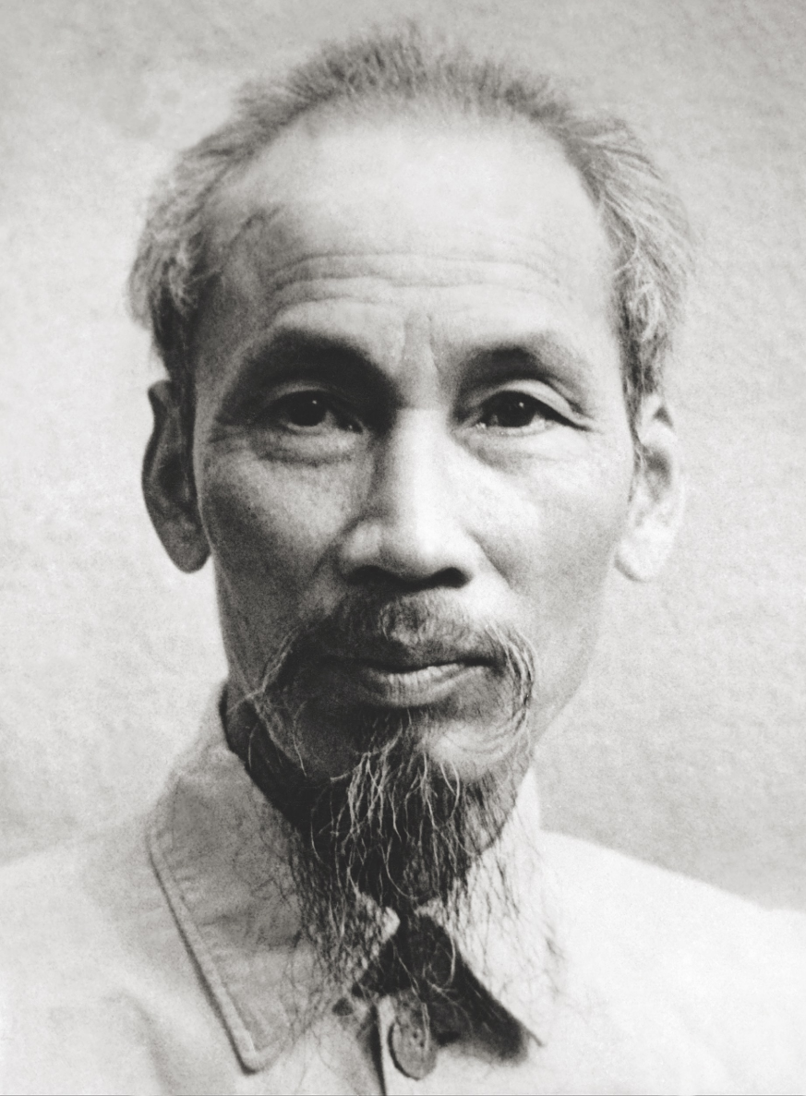
Ho Chi Minh (1890-1969)
Father Confucian priest
…French school Vietnam
... Attend college Paris/ pastry chef
…no money, works on ships
Settles France…1917..studies
Communism…joins Vietnamese
Independence movement.
….asks USA for support…rejected …moves to USSR/then China
Leads Indochina Communists. Writer
…famous…becomes leader…
….to Vietnam 1941…leads Viet Minh
To replace Japanese…asks Truman
for support …rejected…Communist
Revered…undisputed leader of North

Slide 17
North Vietnam: “Democratic” Republic of Vietnam
Population 16 million, 90% peasants, 10% urban,
Government promoted aetheism, most of public Bhuddist, Catholics 4%
GDP per capita $500 (2024) …educated elite
Financial aid from USSR and China
Communist Dictatorship
Centralised economy, extensive security
Dissent crushed/ executed/ limited religious freedom
Land Reform delivered: Landlords “re-educated” or executed
Regime stabilises power 1954-1959
Begin campaign of reunification with South 1959

Slide 18
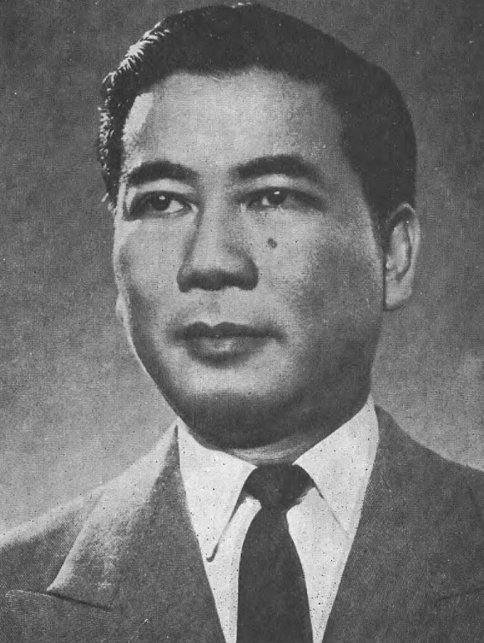
Ngo Dinh Diem (1901-1963)
Born to Catholic family
Father civil servant for French pupped
Emperor Bin Dao..ambassador to Malaya
…burned alive by Buddhist mob
Considers priesthood (as brother)
…joins Civil Service/ …Governor
…anti communist/ nationalist
…exiled by Bin Dao..moves to Japan, US, Europe
Returns to Vietnam 1954
…appointed by Bin Dao and US as Prime Minister
(vs French advice), English speaker Anti Communist
Refuses Referendum, rigs 1955 election (98.5% vote!)
Considered “puppet”of Americans….but nationalist
….Aggressive, ruthless, effective
… Government as “family business”
….chief advisors younger brother & wife Madam Nho

Slide 19
South Vietnam (Republic of Vietnam)
Population 16 million, 80% rural villagers,
Religious freedom …Government Catholic, population 90% Buddhist, 10% Catholic
Average income $1,000 per year (2024) ..double North(vs US $82,000, UK $50,000)
Financial aid from USA
Authoritarian centralised “family” government
Rigged elections (99.5% “approval)
Minimal allowed opposition/ relatively free media, private institutions & business
Initial Land Reform plans fail (1954-1959)
10% of land redistributed…..Landowners retain control
“Aggroville” programme…forcible relocation of peasants within armed camps
………….fails due to violent resistance by loose coalition nationalists/ communists
Solution: Transform Society via “Strategic Hamlet Programme

Slide 20
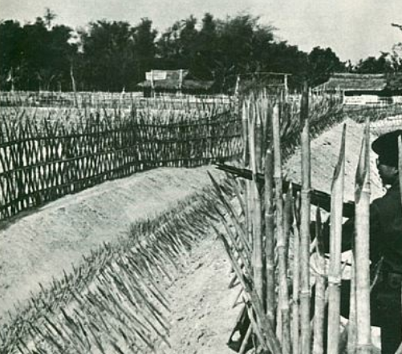
Strategic Hamlet Programme (1959-1963)
The idea: transform society by turning villages into modern settlements (as in US)
Process
Clear area of resistance
Hold by building fortress/ surrounding farms
Build…infrastructure, schools, shops.
…US to provide building materials, advisors
Problems
Peasant resistance….land attachment
Corruption…bias to preferred landlords
Rushed…8,000 hamlets planned
…indefensible/ incomplete
Viet Cong (South Vietnamese communist
…campaign of sabotage & assassination

Slide 21
Viet Cong
Origins
Communist revolutionaries fighting French .
Triggered by Diem rejection of Referendum/ failed “Land Reforms”
Organisation
Alliance with liberal Nationalist groups: National Liberation Front formed 1960
North Vietnamese assume leadership1959…pose as indigenous to south.
Highly organised into cells…numbers rise from 100,000 to 300,000 by 1963
Standing army plus local militia living among population
Tactics
Blend in with peasants/ austere/ non corrupt
Operate by night…propaganda meetings…US “imperialists….French returned
Kill vs landlords, civic leaders, collaborationists….and their families
Increases strength…control 20% S Vietnam by 1963…and growing

Slide 22
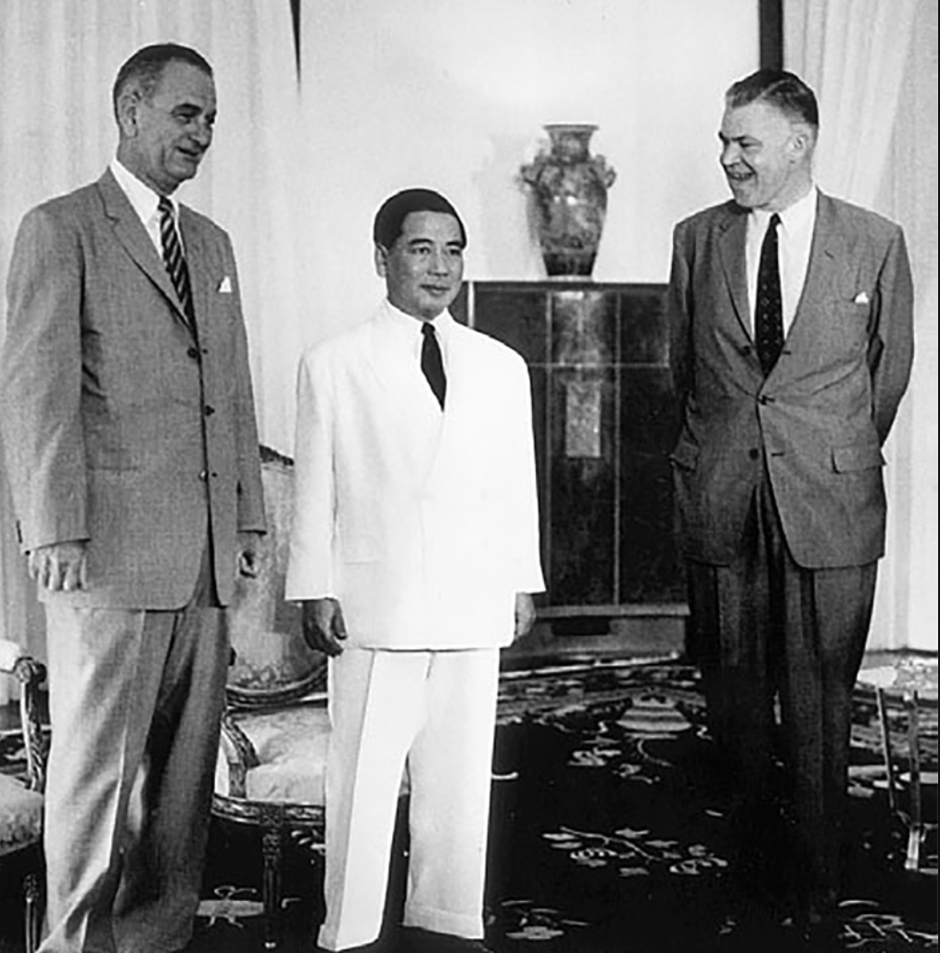
Diem visit to Washington 1961 …meeting with VP Johnson to seek aid …..“he may be a son of a bitch, but he was our son of a bitch” JFK authorises increasing advisors (from 700, 1960 to 16,000 1963)

Slide 23
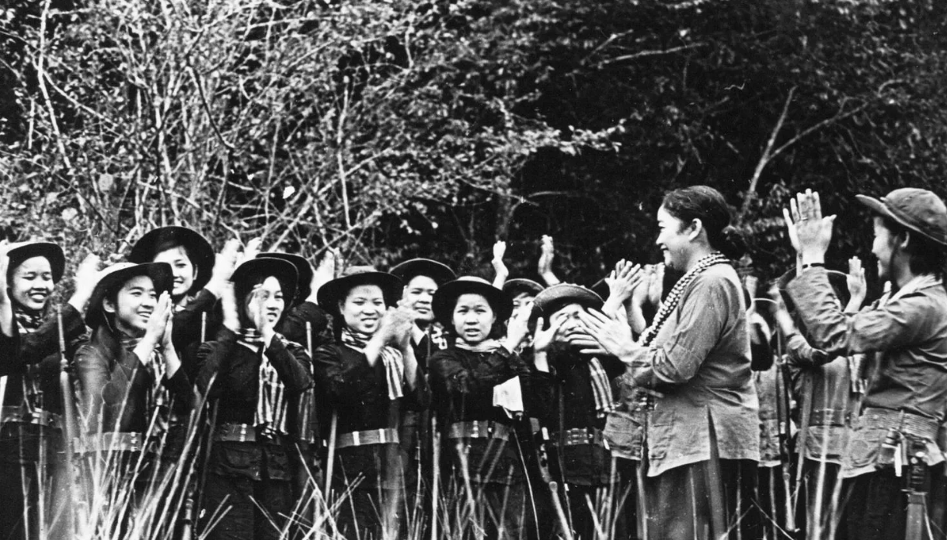
Long Haired Army
Nuyen Thi Dinh (1920-1992) …Mekong Delta 1963
Women’s movement
….spontaneous reaction
In relocated villagers
…Mekong Delta revolt 1960
Incorporated into “National Front2
….70% membership
….Logistics/ support roles
Fighting battalions
….Created 1963
….Nuyen Thi Dinh leader
….active part of VC army

Slide 24
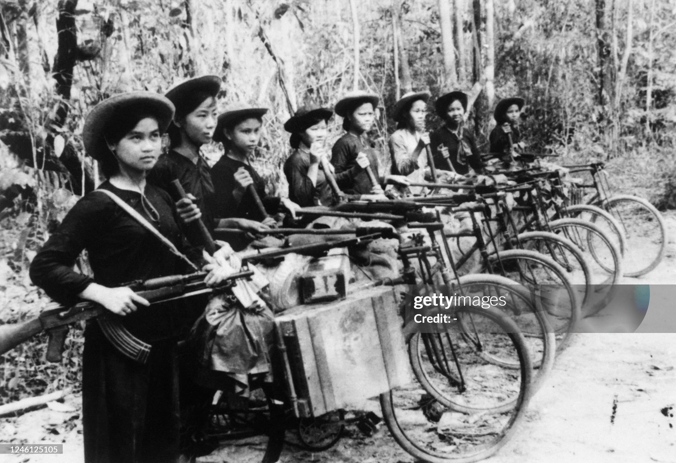
Viet Cong preparing to attack

Slide 25
Coup of 1963
Resistance to Diem regime grows 1961-1963
Buddhist peace demonstrations repressed
Diem “Catholic campaign”…monks classed as “communists”
Self immolation of monk July 1963…. Riots across Vietnam
Coup
Vietnamese Army asks for permission to remove Diem August 1963
JFK says US “will not oppose” revolt by army officers..sends $500K cash for Diem
Diem murdered Nov 1st 1963/ JFK assassinated November 22nd
North sees opportunity
….send 100,000 volunteers South to join Viet Cong

